Slide 1
- Getting started - Basic Functionality
Tryton By Example
Github - https://github.com/clixwise/tryton-by-example Version of presentation : 6.0 Version of Tryton : 6.0 Verified for execution on : Windows 10 & Powershell 7 Licence : CC BY 4.0 Author : Marc Rottiers

Slide 2
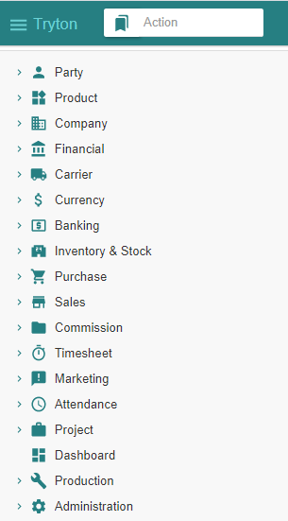
Table of Contents

Slide 3
TOC
Login & Logout
Configuration Wizard
Navigation & Action
Module
Basic Configuration
Country & Currency
Party & Company & Employee
User
Financial
User Authorization
User interface
Wizards to execute some administration How to access and perform Operations
Explaining the concept of Modules
Basic Configuration
Installing Country & Currency modules
Installing Party & Company & Employee modules
Installing additional Users
Installing Financial modules
Demonstrate user privileges

Slide 4
Login & Logout

Slide 5
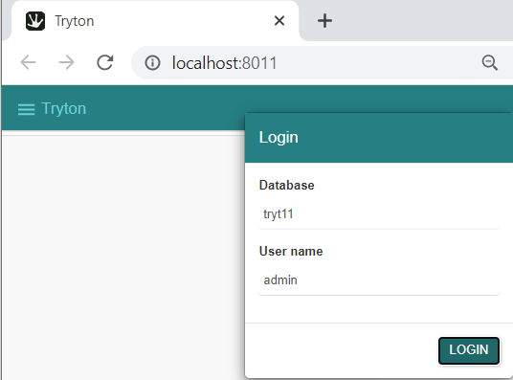
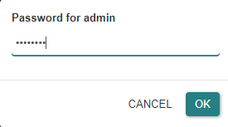
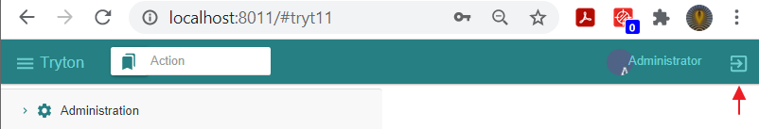
Login & Logout
We login with the previously installed configuration :
Database : « tryt11 »
User : « admin »
Password : « Password »
We logout before we backup the database

Slide 6
Configuration Wizard

Slide 7
Initial Wizard

Slide 8
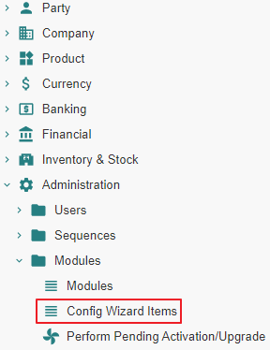
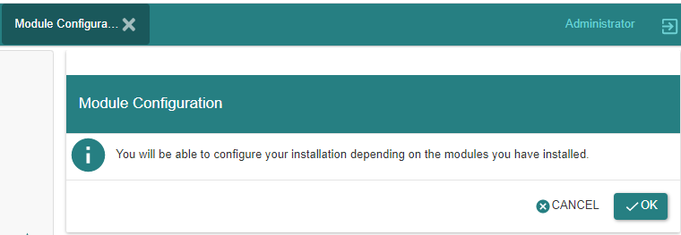
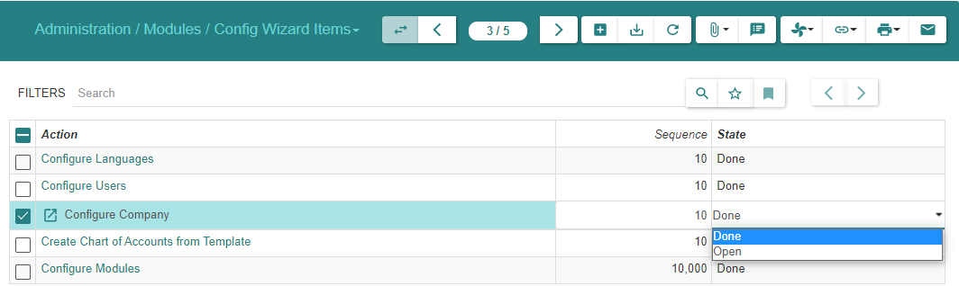
Initial Configuration Wizard
This wizard allows :
To add languages,
To define new users and
To activate functional modules
Additional wizards will be installed as more modules are added to the system.

Slide 9
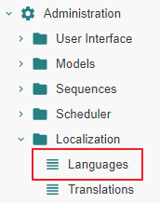
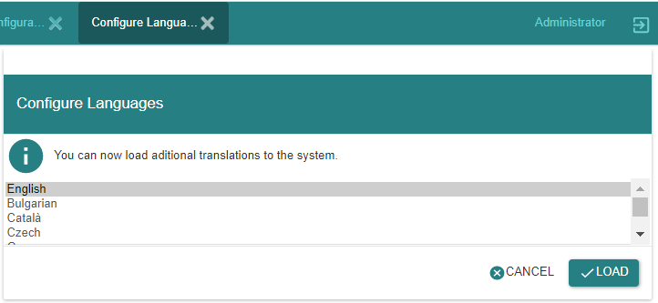
1. Adding « Languages »
This wizard allows to define new languages
If languages must be added later on, we can also directly access the menu item « Languages »

Slide 10
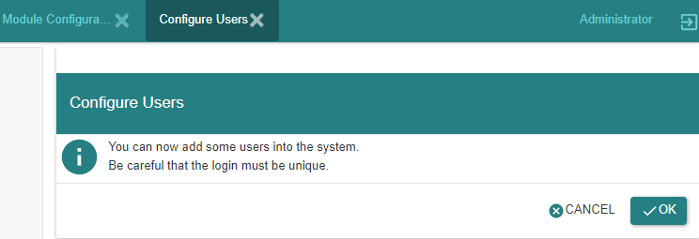
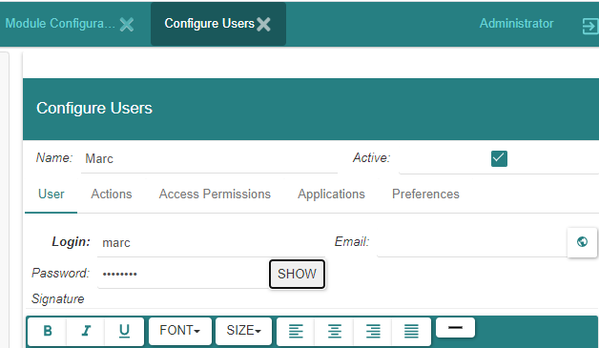
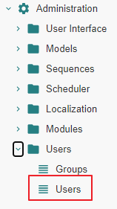
2. Defining « Users »
« User Administrator » is initially used to log into the system
It is then possible to define additional users
In this introductory documentation, we nevertheless perform most (if not all) operations with « User Administrator »
Additional users can allways be defined later by accessing the menu item « Users »
Note that users cannot be deleted ; they can only be deactivated

Slide 11
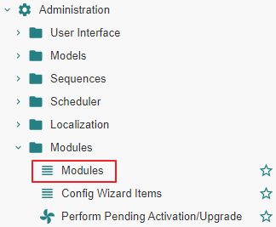
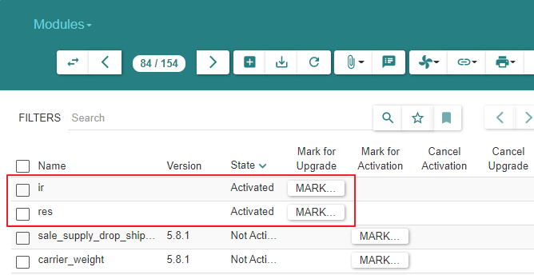
3. Activating « Modules »
Initially
Initially, all but two modules are activated : « ir » and « res »
We do not activate additional modules at this stage
User Administrator
Modules must be activated for this user to access functional subject areas s.a. « Party », « Sale », etc.
As we progress in our understanding of the system, we will activate modules along the way.
We do this by refering to the menu item « Modules ».
Other users
At the end of this document, we will show how to activate access to subject areas for other users.
We will do so thru Menu Tree Items « User Groups » or « User Roles ».

Slide 12
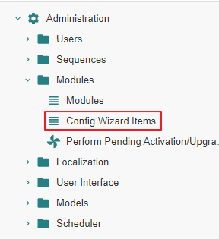
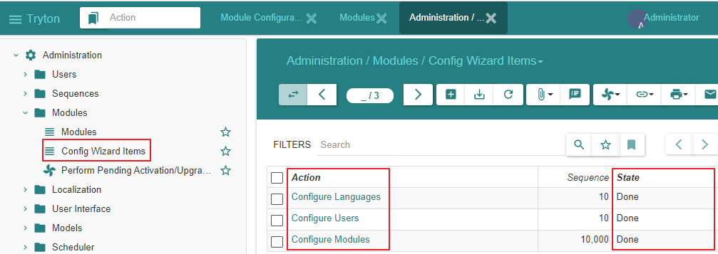
Re-executing wizards - Method 1 - Step 1
The Configuration Wizard Items are accessed as shown above
If they are in state « Open », they have not been executed
If they are in state « Done », they have been executed with or without actually performing the corresponding functionality i.e. configuring a language, a user, a module.
In the later case, the next slide shows how to execute a Wizard Configuration Item once again.

Slide 13
Wizards

Slide 14
Motivation
All operations are accessible from the Menu Tree on the left of the screen
Some of these operations can also be executed using a « Configuration Wizard »
We provide exemples of both techniques for the latter case

Slide 15
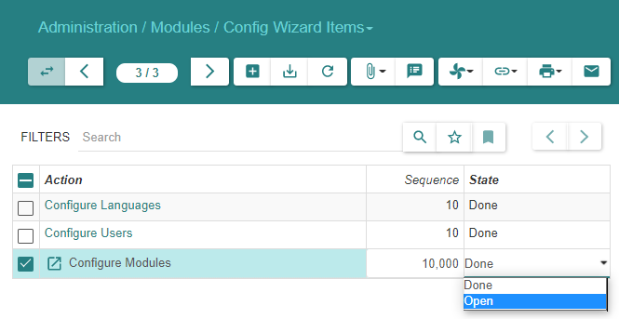
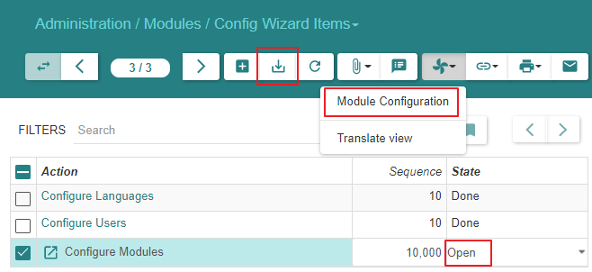
Re-executing wizards - Method 1 - Step 2
We need to reopen the wizard item in order to execute it again : in this case, we use the wizard item to « Configure Modules » once again

Slide 16
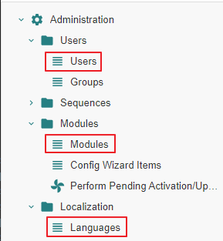
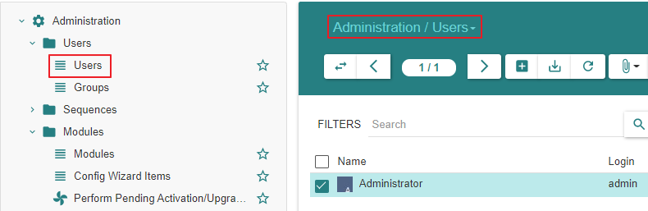
Re-executing wizards - Method 2
Instead of repeating the execution using a wizard operation one can directly access the functional item in the Menu Tree on the left of the screen : « Users », « Modules », « Languages »
Here we access « Users » to define a new user.

Slide 17
Navigation & Action

Slide 18
Motivation
Before exploring the functional aspects of the system, we explain the different widgets that support navigation in the system and actions that trigger operations on items and item lists.
Please revisit this section whilst getting acquainted with the system subject areas.

Slide 19
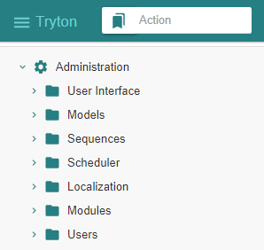
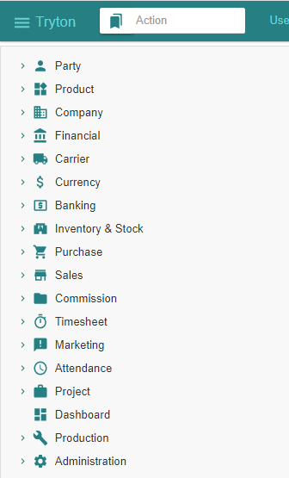
Application - Menu Tree - Triggering operations
The amplitude of the menu tree depends on which application modules have been activated (i.e. installed) for a given user. See next section.
Application modules belong to functional subject areas that are reflected in the Menu Tree : « Party », « Product », etc.
State of Menu Tree when
Initial modules activated
State of Menu Tree when
All modules activated

Slide 20
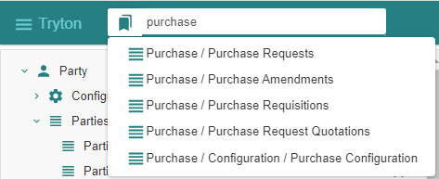
Application - Menu Tree - Search for menu item containing e.g. « Purchase »
A search mechanism exists for the tree of menu items
Here we assume that the « Purchase » modules have been activated and search for some related functionality

Slide 21
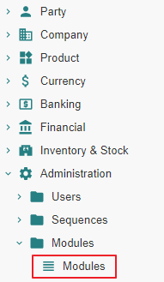
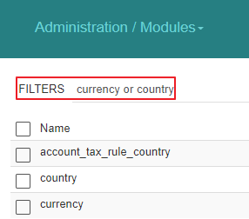
Entity - Filters
The filters select the « Name » values
Here an example for the list of « Modules »

Slide 22
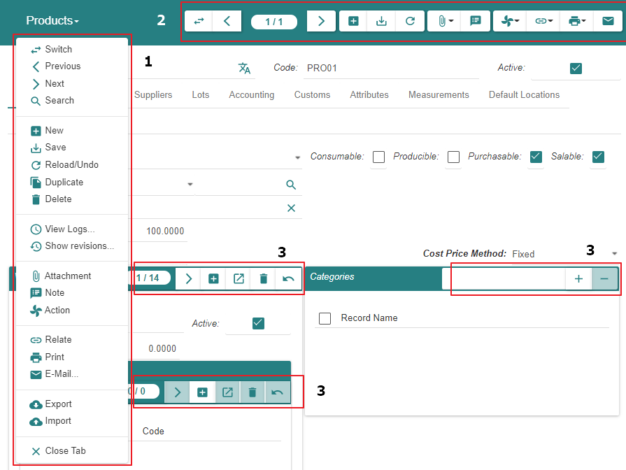
Entity - Menu Bars - An overview
Vertical menu bar displays all possible operations
Horizontal menu bar displays some entity or list operations
Horizontal menu bars display intra-entity operations

Slide 23
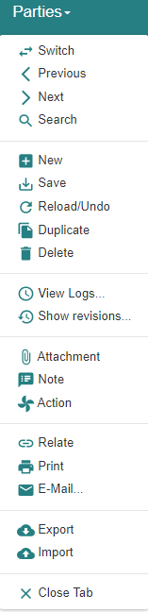
Entity - Menu Bars - Vertical Menu Bar
1
2
3
4
5
6
7
8
9
10
11
12
13
14
15
16
17
18
19
1 switch view from « item list » to « item »
2 « item » : previous in list
3 « item » : position in list
4 « item » : next in list
5 « item » : start adding
6 « item » : save
7 « item list » or « item » : reload / undo / refresh
8 « item » : duplicate
9 « item » : delete
10 « item list » : perform operation that is specific of this list
11
12 « item » : attach one or more documents (e.g. of type docx, xlsx, etc.)
13 « item » : attach a note
14 « item » : actions that are specific of the entity
15
16 « item » : print
17
18
19

Slide 24
Entity - Menu Bars - Horizontal Menu Bar
1 2 3 4 5 6 7 8 9 10 11 12 13
1 switch view from « item list » to « item » (*)
2 « individual record » : previous in list
3 « individual record » : position in list
4 « individual record » : next in list
5 « individual record » : start adding
6 « individual record » : save
7 « individual record » and « record list » : reload / undo / refresh
8
9
10 « record list » : perform operation that is specific of this list
11
12 « individual record » : print
13

Slide 25
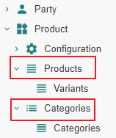
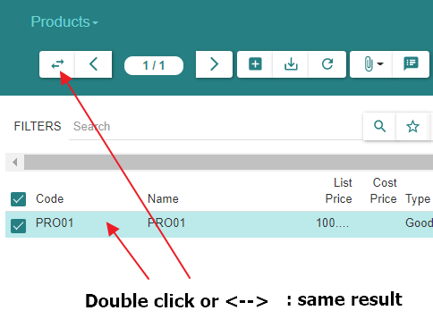
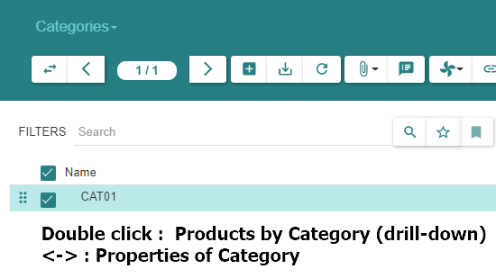
Entity - « Item Double-Click » vs « Menu Item Navigation »
When displaying a list of items, double-click on one of them mostly generates the same result as « <- -> ».
There are however exceptions whereby :
« <- -> » displays either nothing or details about the item itself.
« double-click » provides a « drill-down view » of objects belonging to the item
Examples
« Chart of Accounts » <- -> : displays nothing
« Chart of Accounts » double-click : displays the transactions for that account
« Product Category » <- -> : displays details about the category
« Product Category » double-click : displays the « Products » that belong to this « Category »

Slide 26
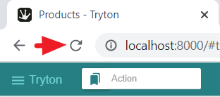
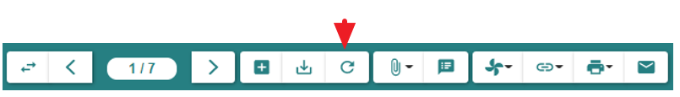
Application or Entity - Data Refresh Requirements
Sometimes it is necessary to refresh the screen using the « Browser Page Reload » button or the relevant menu item (see below).
This may happen e.g.
In the case of « Switching » from « Item » view to « List » view. For instance, when state information in a « Sales Order », e.g. « Draft », has been changed in the « Item » view it might incorrectly persist in the « List » view though it has evolved e.g. to « Confirmed ».
In the case of updating the « List of Product » sold by a « Supplier » then displaying the « Product » to show the « List of Suppliers »
In the case of adding a « Product Variant » in the « List of Variants », it is necessary to refresh the « Product » itself to take the variant into account on the screen

Slide 27
Module

Slide 28
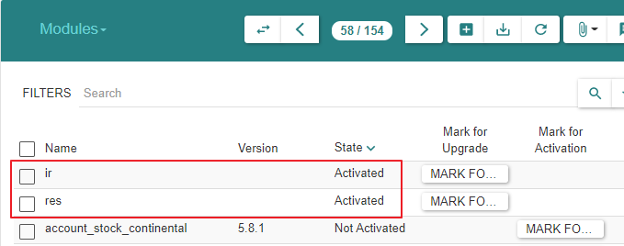
Motivation
The « Application » is implemented by « Modules » that use « Database Tables » and « Files » optionally. Modules are not explicitly grouped into functional subject areas.
Initially, all but two modules (« ir » & « res ») are inactivated : see below. The activation relies technically
Either on the usage of wizards and a mutual dependency mechanism.
Or based on their name by grouping them based on their prefix.
When modules are activated,
The database tables they use are created if required.
The menu items are added in the Tree on the left of the screen.

Slide 29
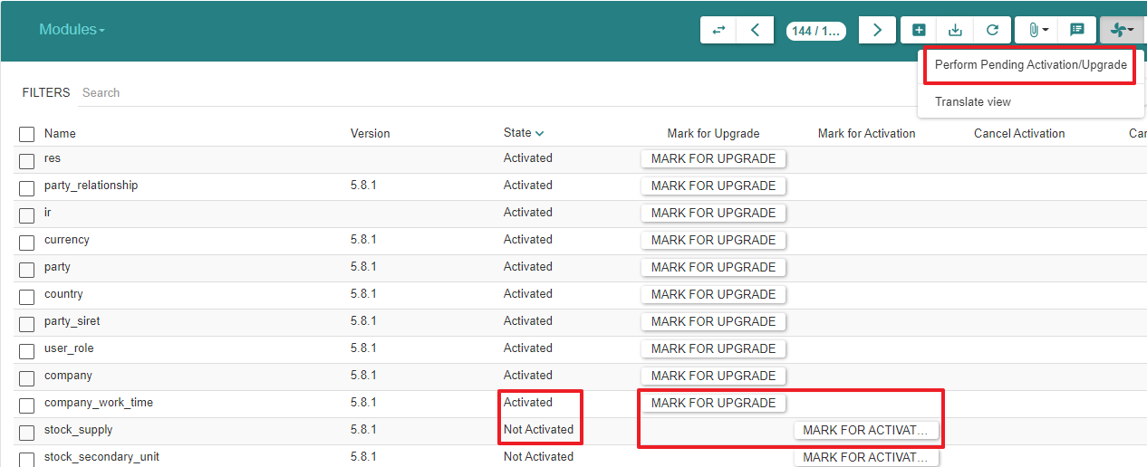
Modules
- Tryton optimizes operations by requiring activation of application modules.
- We will activate modules as we progress instead of activating all modules at once

Slide 30
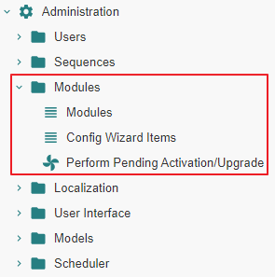
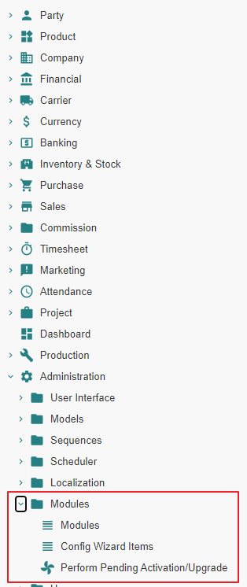
Modules
Growing list of menu items : initial & final list of menu items as modules are being installed

Slide 31
Basic Configuration

Slide 32
Motivation
Before examining the typical ERP transactions like « Sales », etc. we need to activate modules that support the different « basic subject areas ».
This link refers to official documentation about a « basic configuation » : https://tryton-administration-manual.readthedocs.io/en/latest/basic_config.html

Slide 33
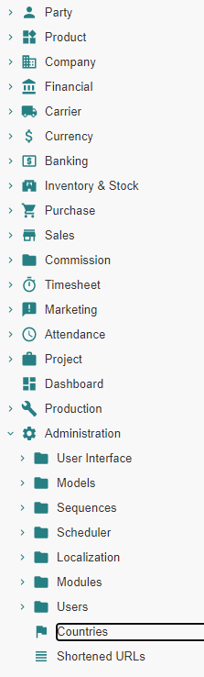
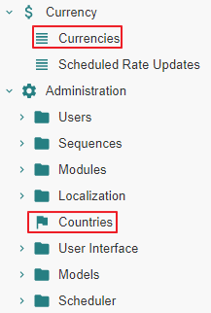
« Country » & « Currency »

Slide 34
Motivation
The TRYTON database and application contain minimal database tables and application modules. « Countries » and « Currencies » are extensively used. Hence, it is advised to :
Activate the corresponding application modules thereby also creating the required tables in the database.
Load the tables with ISO normalised « Currency » and « Country » data
Finally, for each « Currency » of use in the « Company » operations, it is advised to :
Set the « Rate » property to 1.0 for a « Reference Currency » ; f.i. « EUR rate » = 1.0
Set the « Rate » property to a relative value for each « Relative Currency » ; f.i. « USD rate » = 1.2
When the « Company » operates in a single currency environment, the « 1.0 » multiplication factor is used
When the « Company » operates in a multi-currency environment, each currency-related rate is used as multiplication factor

Slide 35
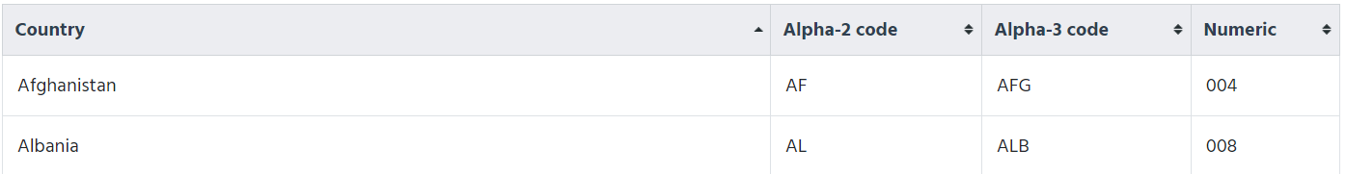
Documentation
https://docs.tryton.org/projects/modules-country/en/latest/

Slide 36
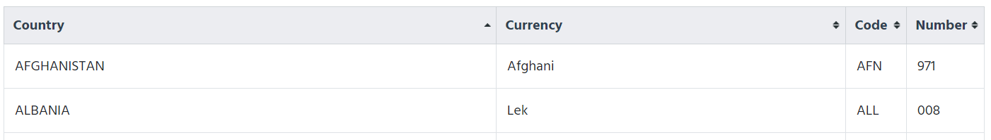
Documentation
https://docs.tryton.org/projects/modules-currency/en/latest/

Slide 37
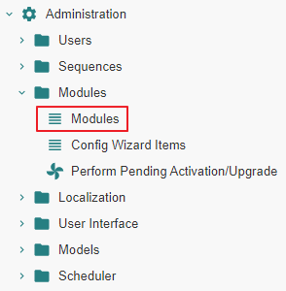
Application - Activating the Modules

Slide 38
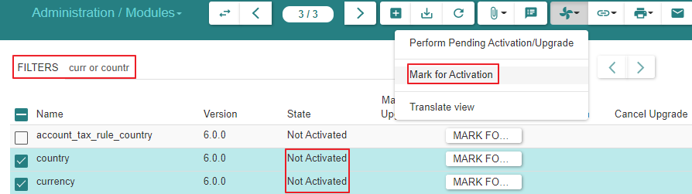
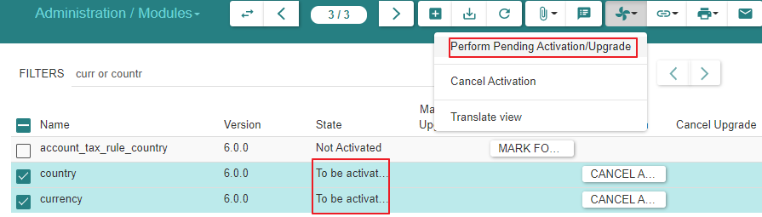
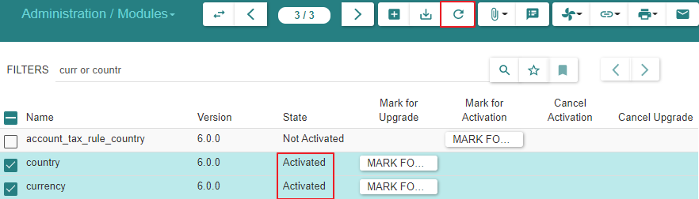
Activate « Country » & « Currency »

Slide 39
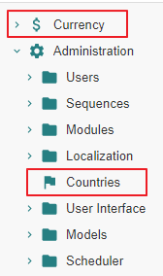
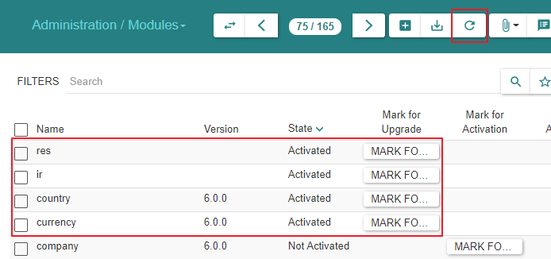
Activate « Country » & « Currency »
Note :
Use TRYTON « Reload » operation to refresh and display
« Countries » & « Currencies » appear in the Tree Menus
When clicking « Countries or « Currency », the data panel remains empty : we need to load the database tables

Slide 40
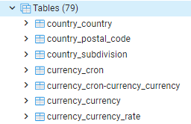
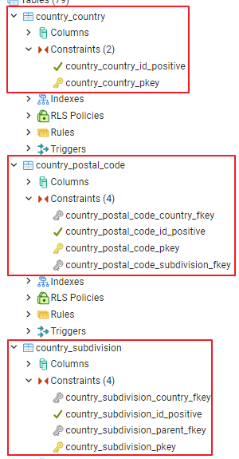
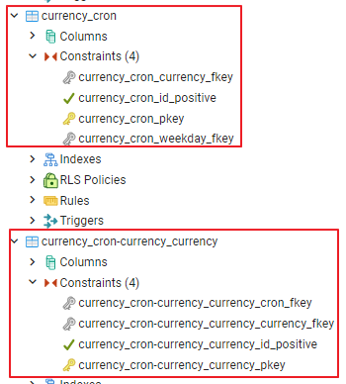
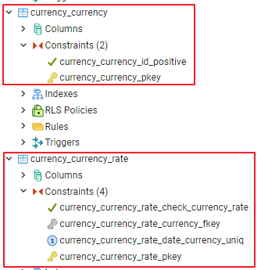
Activate « Country » & « Currency »
There are 3 additional « country » tables
There are 4 additional « currency » tables
All tables are still empty

Slide 41
Database – Loading the Tables

Slide 42
Scripts
Load TRYTON tables “Countries” & “Currencies”
Tryton 6.0 - Doc 05.01 - Basic functionality.import.tryt11.countries | Fill table with ISO countries
Tryton 6.0 - Doc 05.01 - Basic functionality.import.tryt11.currencies | Fill table with ISO currencies
[https://discuss.tryton.org/t/data-base-importing-countries-or-currencies/3811/7]
Special credits to David Harper

Slide 43

« Country » - Load data

Slide 44


« Country » - Load data

Slide 45


« Country » - Load data

Slide 46

« Currency » - Load data

Slide 47


« Currency » - Load data

Slide 48


« Currency » - Load data

Slide 49
« Currency Rates »

Slide 50
Motivation
Multi-currency operations are supported
In this is required, we need to define the rates for :
A « Reference Currency Rate » ; that rate will be 1.0
One or more « Relative Currency Rates » ; those rates will be relative to the reference rate.
Exemple :
Our reference currency is EUR : its rate is 1.0
One or our relative currencies is USD : ist rate is 1.2 (2021)
For each relative currency, we define as many dates as we want considering those dates are « Dates From » for the relative rate applicable from that moment onward.

Slide 51




Setting a « Reference Currency Rate » as of « Date from »
« EUR » is our « Reference Currency Rate ». Hence we set the rate at value 1.0

Slide 52



Setting « Relative Currency Rates » as of « Date from »
« USD » is used in our « Company »
So one of the « Relative Currency Rates » pertains to that « Currency ». Hence we set the rate at value 1.2 as of 2021-01-01 with respect to the « EUR »
We can define additional « Relative Currency Rates »
For other currencies
For other « Date from » values

Slide 53


Summary

Slide 54
« Party » & « Company » & « Employee »

Slide 55
Motivation
We activate modules and create database content related to the following entities :
« Party » : an entity that represents some ERP-relevant actor
« Company » : a specialized « Party » entity
« Employee » : a specialized « Party » entity
« Parties associated to Sales » : a « Party » role (activated and installed later)
« Parties associated to Purchases » : a « Party » role (activated and installed later)
Party associated to Sales
Party
*
Party associated to Purchases
Company
Employee
Legend
Entity
Entity
Entity Role
Entity Role
* : This specialization is exclusive and not complete

Slide 56


Motivation
« User » vs. « Party »
A « User » is a user of the system with login and password.
A « User » is not a « Party ».
A « User » is not necessarily an « Employee » of the « Company ». F.i. he/she can be a consultant.
The default user is « admin ».
The content of the « res_user » database table with « User » entities
The content of the « party_party » database table with « Company », « Employee » and « Supplier » (installed later) entities

Slide 57
« Party »

Slide 58
Motivation
A « Party » is an entity that stands for the common properties of a speciliazed entity such as « Company », « Employee », or a role entity like « Party associated to Purchase », etc.
We activate the modules that relate to « Party ». Subsequently, we define specialized parties :
The first approach :
First define a « Party » with the idea that it will be referenced by a specialized entity.
Subsequently define the specialized entity (e.g. a « Company ») with reference to its « Party » parent.
The second approach :
Define the specialized entity like « Company »
Doing so, the system lets you create the « Party » entity on the fly

Slide 59
Module Activation

Slide 60
Documentation
[https://docs.tryton.org/en/latest/party.html#index-party]

Slide 61


Modules - Activation
We ensure that all « Party » modules are activated

Slide 62


Modules - Activation
We ensure that all « Party » modules are activated

Slide 63
« Party » - The entity

Slide 64


« Party »
Allthough the « Party » modules are activated and accessible, we defer using them, after activating respectively :
« Party Specializations » like « Company », « Employee » or
« Party Roles » like « Parties associated with Sales or Purchases »

Slide 65
« Party » Configuration

Slide 66


« Party » Configuration
The Party Sequence
The Party Identifier Type
The Party Language

Slide 67



« Party » Configuration : the sequence format
Definition accessible thru « Party Configuration » or « Administration Sequences »

Slide 68
Creation of Parties

Slide 69

« Party », « Company » & « Employee »
A « Party » is an entity.
Its subentities are of type « Company », « Employee », etc.
We can define these entities in two ways :
Method 1 :
We define a « Party » « X » or « Y » by clicking on « Parties », and fill their properties conformant those inherited by the subentity
Subsequently, we define :
The « Company » « X » by referencing its corresponding « Party » « X »
The « Employee » « Y » by referencing its corresponding « Party » « Y »
Method 2 :
We define the « Company » « X » by clicking on « Companies » and in doing so we create « Party » « X » in the process
We define the « Employee » « Y » by clicking on «Employees » and in doing so we create « Party » « Y » in the process
We will use Method 1 for defining a « Company » COM01
We will use Method 2 for defining an « Employee » EMP01

Slide 70
« Company »

Slide 71



Modules - Activation
We ensure that all « Company » modules are activated

Slide 72



Modules - Activation - Summary State

Slide 73


Create « Company » COM01
Step 1
Create the « Party » COM01
Step 2 Create the « Company » subentity COM01 that references the « Party » entity COM01

Slide 74
« Employee »

Slide 75
Modules - Activation
By activating the « Company » modules, both the « Company » and « Employee » parties are made available
There are no « Employee » modules to activate

Slide 76



Creating « Employee » EMP01
We create « Employee » EMP01
In the process,
We create its corresponding « Party » EMP01
We reference the existing « Company » COM01

Slide 77



Creating « Employee » EMP01
The « Employee » appears now
In the list of employees
In the list of employees for « Company » COM01

Slide 78
Final State

Slide 79



« Party », « Company », « Employee »

Slide 80
« User »

Slide 81

« User » - Relationship to « Employee » and « Company »
A « Company » aggregates « Employees », not « Users »
An « Employee » is a « Party », a « User » is not
A « User » references all « Company » and « Employee » he/she manages
A « User » references a « Current Company » and a « Current Employee »
A « User » is someone who logs into the system with user id and password
The « User » - « Company » link allows installation and display of relevant company records
For instance, the « admin » - « COM01 » link will authorize the creation of a « COM01 » Chart of Accounts

Slide 82
Summary
Party associated to Sales
Party
Party associated to Purchases
Company
Employee
Legend
Entity
Entity
Entity Role
User
Entity Role

Slide 83
« User » Administrator

Slide 84

« User » - Relationship to « Employee » and « Company »

Slide 85
« User » Marc

Slide 86

Motivation
We initially added « User Marc » using the « Initial Configuration Wizard »
We now define « Employee EMP02 » for « Company COM01 »
We link « User Marc » to him/her
We briefly login then logout to see what is permitted
Later on, all operations will be performed in this basic introduction with « User » « Administrator »

Slide 87


Motivation
We define « Employee EMP02 » for « Company COM01 »

Slide 88


Motivation
We link « User Marc » to « Employee EMP02 » for « Company COM01 »
We login/logout with « User Marc » to display the current privileges
We will explain later the « User Group » and « User Role » concepts used for attributing user privileges

Slide 89
Application - Activating Modules

Slide 90


Activating module « User_role »

Slide 91
« User » Paula

Slide 92




« User Administrator » creates then deactivates « User Paula »
User « Paula » is installed then deactivated
A user cannot be deleted

Slide 93
« Financials » « Chart of Accounts » & « Fiscal Year and Period » & « Journal »

Slide 94
Chart of Account
We will install the « French » chart of accounts.
Balance Sheet Accounts
Income Statement Accounts
# | French | English
40 | Client | Customer
41 | Fournisseur | Supplier
53 | Caisse | Cash
# | French | English
6x | Charges | Expense
7x | Revenus | Revenue
[https://tryton-administration-manual.readthedocs.io/en/latest/basic_config.html#installing-a-chart-of-accounts]
[https://tryton-administration-manual.readthedocs.io/en/latest/accounts.html]

Slide 95
Activating Modules

Slide 96


Activation
« Mark for Activation »
« Perform pending activation or upgrade »

Slide 97




Activation & Create Chart of Accounts

Slide 98


State - Menu Tree Items
There are additional Menu Items in the Menu Tree

Slide 99


State - Sequence Management Functions
There are additional functions that allow to format the prefix or suffix of record sequences for various entities

Slide 100


State - Wizards
The « Create Chart of Accounts from Template » wizard Item is added in state « done »

Slide 101



State - Chart of Accounts - Account Types

Slide 102



State - Chart of Accounts - Accounts

Slide 103


State - Configuration
Part of the « Configuration » is now defined

Slide 104
State - Company
Notice :
The « Create Chart of Accounts from Template » wizard Item is « done »
The « Company COM01 » has no « Accounting » Tab
There are additional Menu Items in the Menu Tree

Slide 105
Error Case

Slide 106




Error case - « Administration » User not setup
This situation occurs when the « Administration » user is not properly set up
The user must be linked to « Company COM01 » and « Employee EMP01 »

Slide 107


How to recover
We set the link to company « COM01 » & employee « EMP01 »

Slide 108



How to recover - method 1
We modify the wizard state from « done » to « open »
We perform « Module Configuration »

Slide 109




How to recover - method 2

Slide 110

Financial - Fiscal Years & Periods

Slide 111
Documentation
Accounts :
[https://tryton-administration-manual.readthedocs.io/en/latest/accounts.html] Post Move Sequence : [https://groups.google.com/g/tryton/c/a4fobeaYn48]
Opening a Fiscal Year : [https://discuss.tryton.org/t/how-to-create-a-fiscalyear/2380]

Slide 112

Fiscal Years - Sequences

Slide 113

Fiscal Years - Sequences

Slide 114




Fiscal Years - Sequences

Slide 115



Fiscal Years - Periods

Slide 116
Financial - Configuration

Slide 117

Configuration
Additional parameters can be set

Slide 118
Financial - Journals

Slide 119



Journals

Slide 120


Journals

Slide 121



Party

Slide 122

Company

Slide 123

Database

Slide 124


Account Type Templates (1/2)

Slide 125


Account Type Templates (2/2)
Templates are used to generate the actual « Chart of Account ». As such, there is no reference to a « Company »

Slide 126



Account Types (1/2)
The « Account Type » contains a reference to the « Company ». This contrasts with the « Account Type Template » which does not

Slide 127


Account Types (2/2)

Slide 128


Account Templates (1/3)

Slide 129


Account Templates (2/3)

Slide 130


Account Templates (3/3) - Note

Slide 131



Accounts (1/2)

Slide 132



Accounts (2/2)

Slide 133



Problem with closed accounts
[https://discuss.tryton.org/t/value-for-field-account-is-not-valid/3106/9]
Select * from account_account where closed = true;
UPDATE account_account SET closed = false WHERE closed = true;

Slide 134
User Authorizations

Slide 135



Motivation
We experiment in changing user authorizations with respect to accessing subject areas in the application
The « User Administrator » can tailor this by exercising « User Groups » and « User Roles »
We activate module « user_role »

Slide 136
User Capabilities - State Ante

Slide 137


State - User Capabilities

Slide 138
User Groups - Modify

Slide 139


List of « User Groups »
Linking the « User » and the « Group » is possible in two ways :
Method 1 : displaying the choosen group then linking the user to it
Method 2 : displaying the choosen user then linking the group to it

Slide 140


Attach « User Marc » to a « User Group » - Method 1

Slide 141

Attach a « User Group » to « User Marc » - Method 2

Slide 142
User Roles - Modify

Slide 143


« User Roles »
We define a « Role » that aggregates two « Groups »

Slide 144

Attach « User Marc » to a « User Role » 1/2
Once a « Role » is defined, it can be referenced by a « User »
Attaching a « Role » also allows to restrain the « from » and « to » dates

Slide 145


Attach « User Marc » to a « User Role » 2/2
We must also ensure that « User Marc » has a link to « Company COM01 » so as to access those records

Slide 146
User Capabilities - State Post

Slide 147


State - User Capabilities
« User Administrator »
« User Marc »

